Slide 1



Today’s Session: Banking
NPS, TBS, BASEL, 4R, Indradhanush, BBB
MP Incomplete Transmission, MCLR etc.
Differential Banks
PSL-framework, Certi.
Watch L1/P2 to P9
before going further

Slide 2


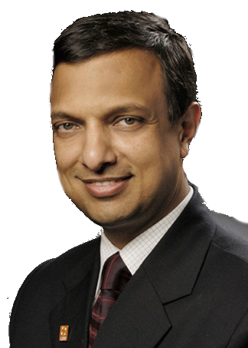

Differential Banks
Small F.Banks
Payment Banks
Wholesale Banks
Custodian Banks
2015: Finished Selection
2016: Apr. Monetary Policy suggested
RBI’s Nachiket Mor Committee on Financial inclusion (2014) Suggested Differential Banks /Niche banking

Slide 3
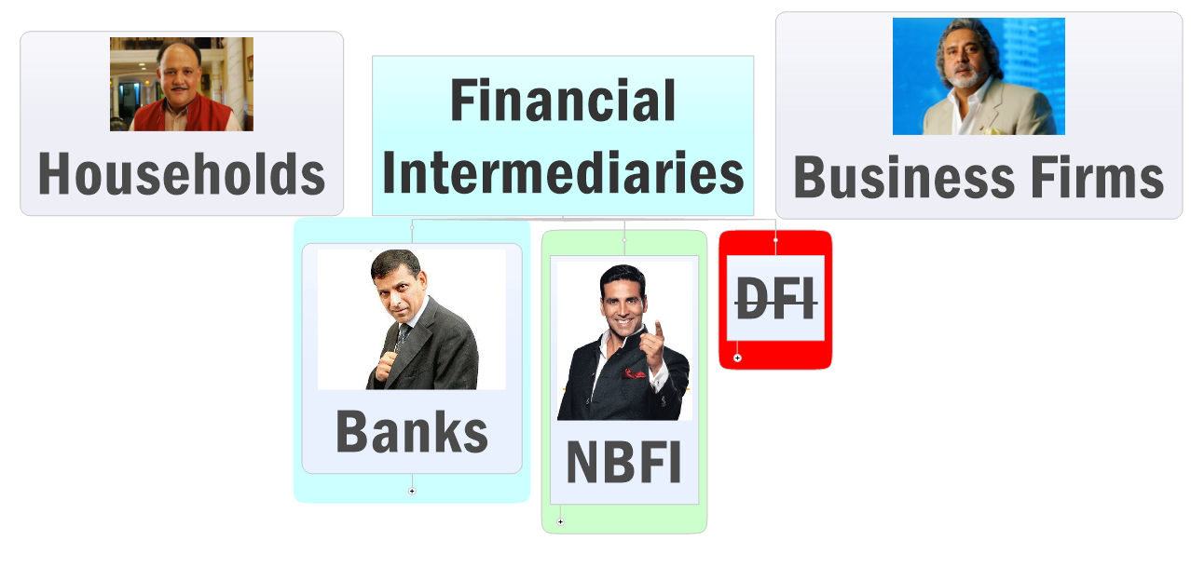
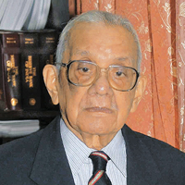
Recap: FI Classification
Gone after Narsimhan-II (1998)

Slide 4
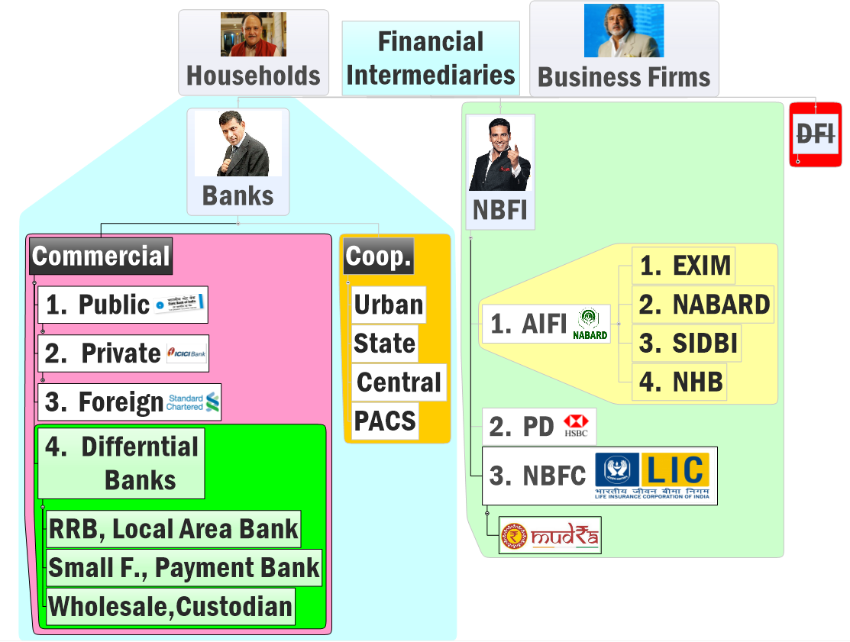

Recap: Classification of Financial intermediaries
More @ L1/P9
Profit motive, voting power as per shareholding
Public / private PSL: 40%
Branch 20/> = 40% PSL; others
PSL: 40% phased manner by 2019
(IYB Page 395) Dr. KC Chakrabarty Committee RRB CRAR 9%; recapi. 40 RRBs. Total 57 RRBs
RRB: 75% PSL; LAB: none
No Profit No Loss;
1 member=1 vote
Small Bank: 75% PSL; Payment.B: none
MUDRA=RBI registered NBFC
TBA

Slide 5
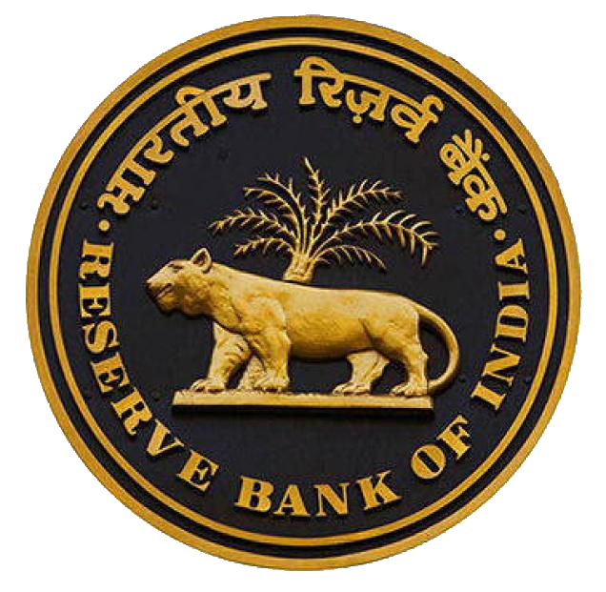
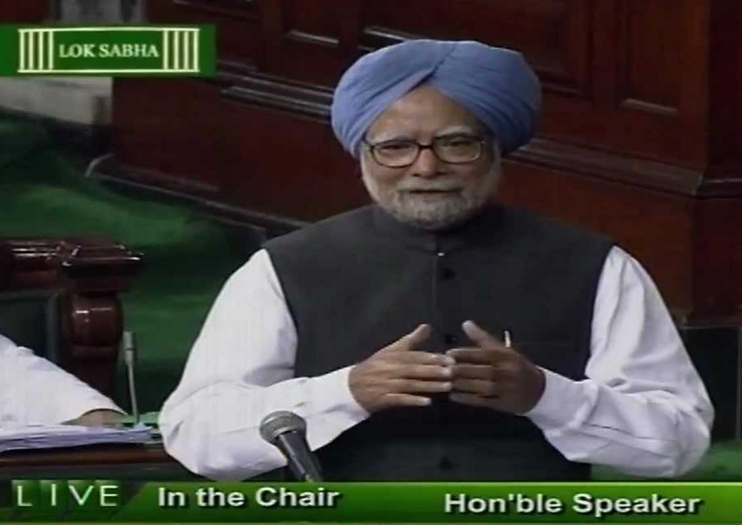

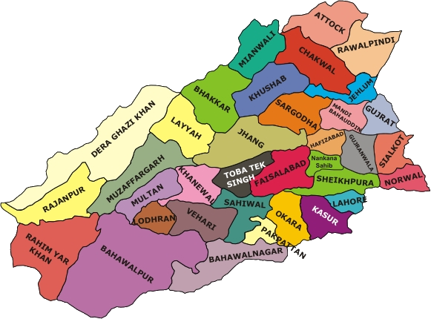
FI ►Bank ► Commercial Bank ► Diff. Bank ► Local Area Bank
Licensed under Banking Regulation Act 1949.
But not in 2nd Schedule of RBI Act 1934
Budget 1996
Only rural and semi-urban areas
Max. 3 geographically contiguous districts.
only 1 urban centre/District
Notes:
Announced in Budget 1996 by Dr.Manmohan Singh
Licensed under Banking Regulation Act 1949. (Section 22)
But not in 2nd Schedule of RBI Act 1934
Only rural and semi-urban areas
Max. 3 geographically contiguous districts.
only 1 urban centre/District
Eligible to convert into small finance banks (=Scheduled Banks)

Slide 6
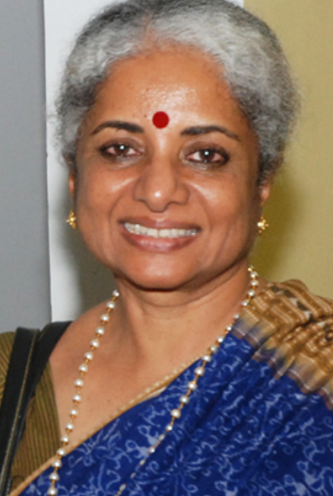

FI ►Bank ► Commercial Bank ► Diff. Bank ► Local Area Bank
Only 4/10 LAB working
Coastal Bank Andhra Pradesh (first '99)
Capital Local Area Bank: Punjab (Largest)
Subhadhra Local Area Bank, Kolhapur
Krishna Bhima Samruddhi (Andhra & Karnataka)
Converted to SFB
1st SFB to start ops
(April 2016)
2015: could apply for Small f. banks
(Usha Thorat Selection Committee)
Small F bank= Sch.banks
Later can even become Universal commercial banks

Slide 7
Since LAB are not scheduled banks (they’ve license banking regulation act but not named in RBI act)
Diffl. Banks
Micro-Small enterprises loans not covered under Credit guarantee scheme of Govt.
Farms loans not covered under Interest subvention scheme (ISS only for PSB, RRB).
No PSL obligations … ☺
State/Central PSUs/institutes don't open account
Branch expansion heavily restricted, need RBI approval.
Can't get loans from RBI @Bank rate /MSF
Can't get refinance from NABAD/SIDBI
What are Scheduled Banks?
RBI Act 1934 Sch.2
Min.Paid up Capital Rs.5 lakh
Protect interest of depositors
Notes:
http://www.business-standard.com/article/finance/differentiated-banking-licence-local-area-banks-hopeful-on-rbi-move-114072201014_1.html
If bank gave 100cr. Then 15% refinance through nabard?

Slide 8
Recap: Classification of Financial intermediaries
More @ L1/P9
Profit motive, voting power as per shareholding
Public / private PSL: 40%
Branch 20/> = 40% PSL; others
PSL: 40% phased manner by 2019
RRB: 75% PSL; LAB: none
No Profit No Loss;
1 member=1 vote
MUDRA=RBI registered NBFC

Slide 9
New Differential Banks
Small F.Banks
Payment Banks
Wholesale Banks
Custodian Banks
2015: Finished Selection
2016: Apr. Monetary Policy suggested
RBI’s Nachiket Mor Committee on Financial inclusion (2014) Suggested Differential Banks /Niche banking

Slide 10
Why Payment banks?
Because Kenya has it!

Slide 11
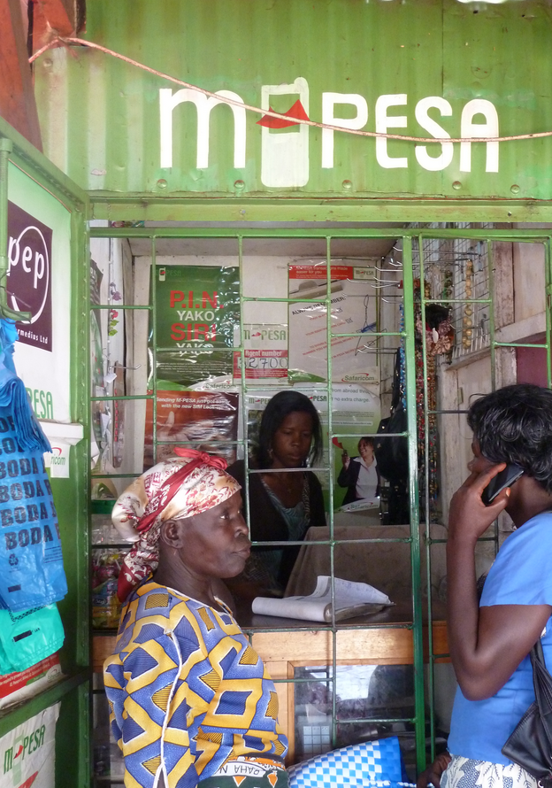
Pesa=swahili word for money.
M-Pesa= Kenya’s Payment Bank tied with Vodafone
Local Kiranawall, petrolpump etc =Agents of M-Pesa
Give’em $$=> Money filled in your Mobile wallet;
mobile becomes debit card.
Remittance (US=>Kenya)- show SMS, get physical cash
Vodafone M-Pesa in Kenya
Notes:
Postmen and money order

Slide 12
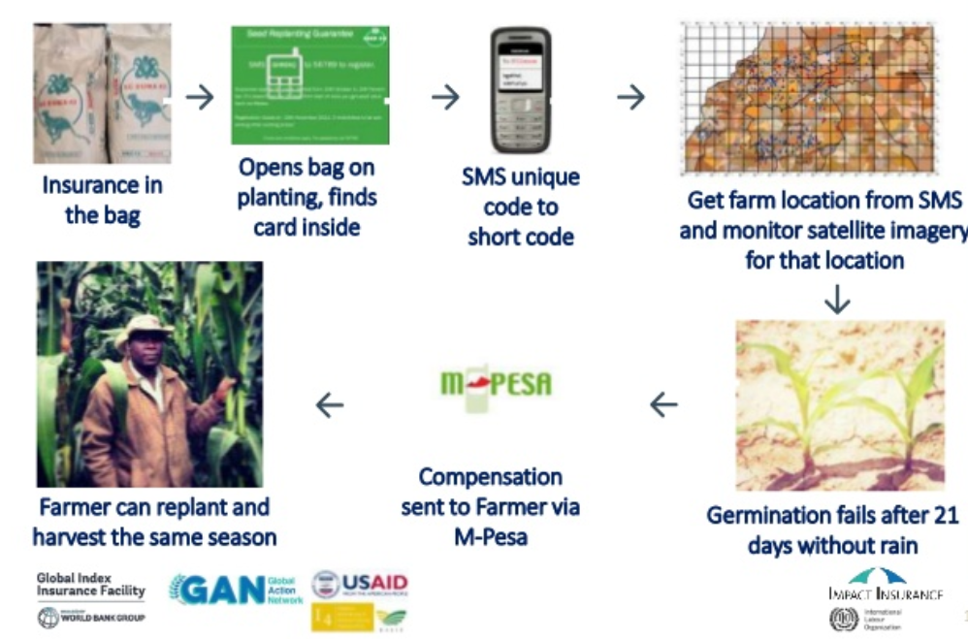
M-Pesa in aid of farmer
Seed insurance
Indian villages have BCs but not “integrated network”
Indian Banks lack personnel to run ops like Mobile companies
Notes:
Indian villages have BCs but not “integrated network”

Slide 13
Cost of Remitting 5,000/- In India
Prepaid (mobile) payment instruments
India-oxygen, Itzcash, Fino-ICICI, Airtel Money, M-Pesa etc.
If formalized into bank accounts = more retail penetration and rural financial inclusion
Hence Nachiket Mor (2014) recommends, RBI Accepts
Money value of “time”

Slide 14
Why small finance banks?
Because America has it!

Slide 15


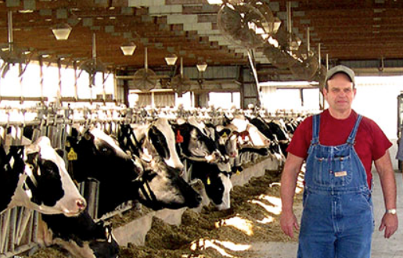


Community banks in USA
Junta can avail loan “without formal credit history or assets”
I know every family, special features of local market = min. NPA, higher % profit than large banks
Small Asset size
Locally owned & operated
Focus on retail businessmen, farming/dairy-livestock families
Notes:
(In theory, India farmer cud get, but kirana-walla won’t)

Slide 16
“Community banks of USA”: Indian parallels
Private
Pre-independence private commercial banks which did not get nationalized: Catholic Syrian Bank in Kerala (1920); Nainital Bank (1922) ; RBL Bank in Ratnagiri (1943)
Public
RRB, Cooperative banks
But each has ~3% in total bank deposits (USA comm.Banks-20%)
Local Area Banks (1996)

Slide 17
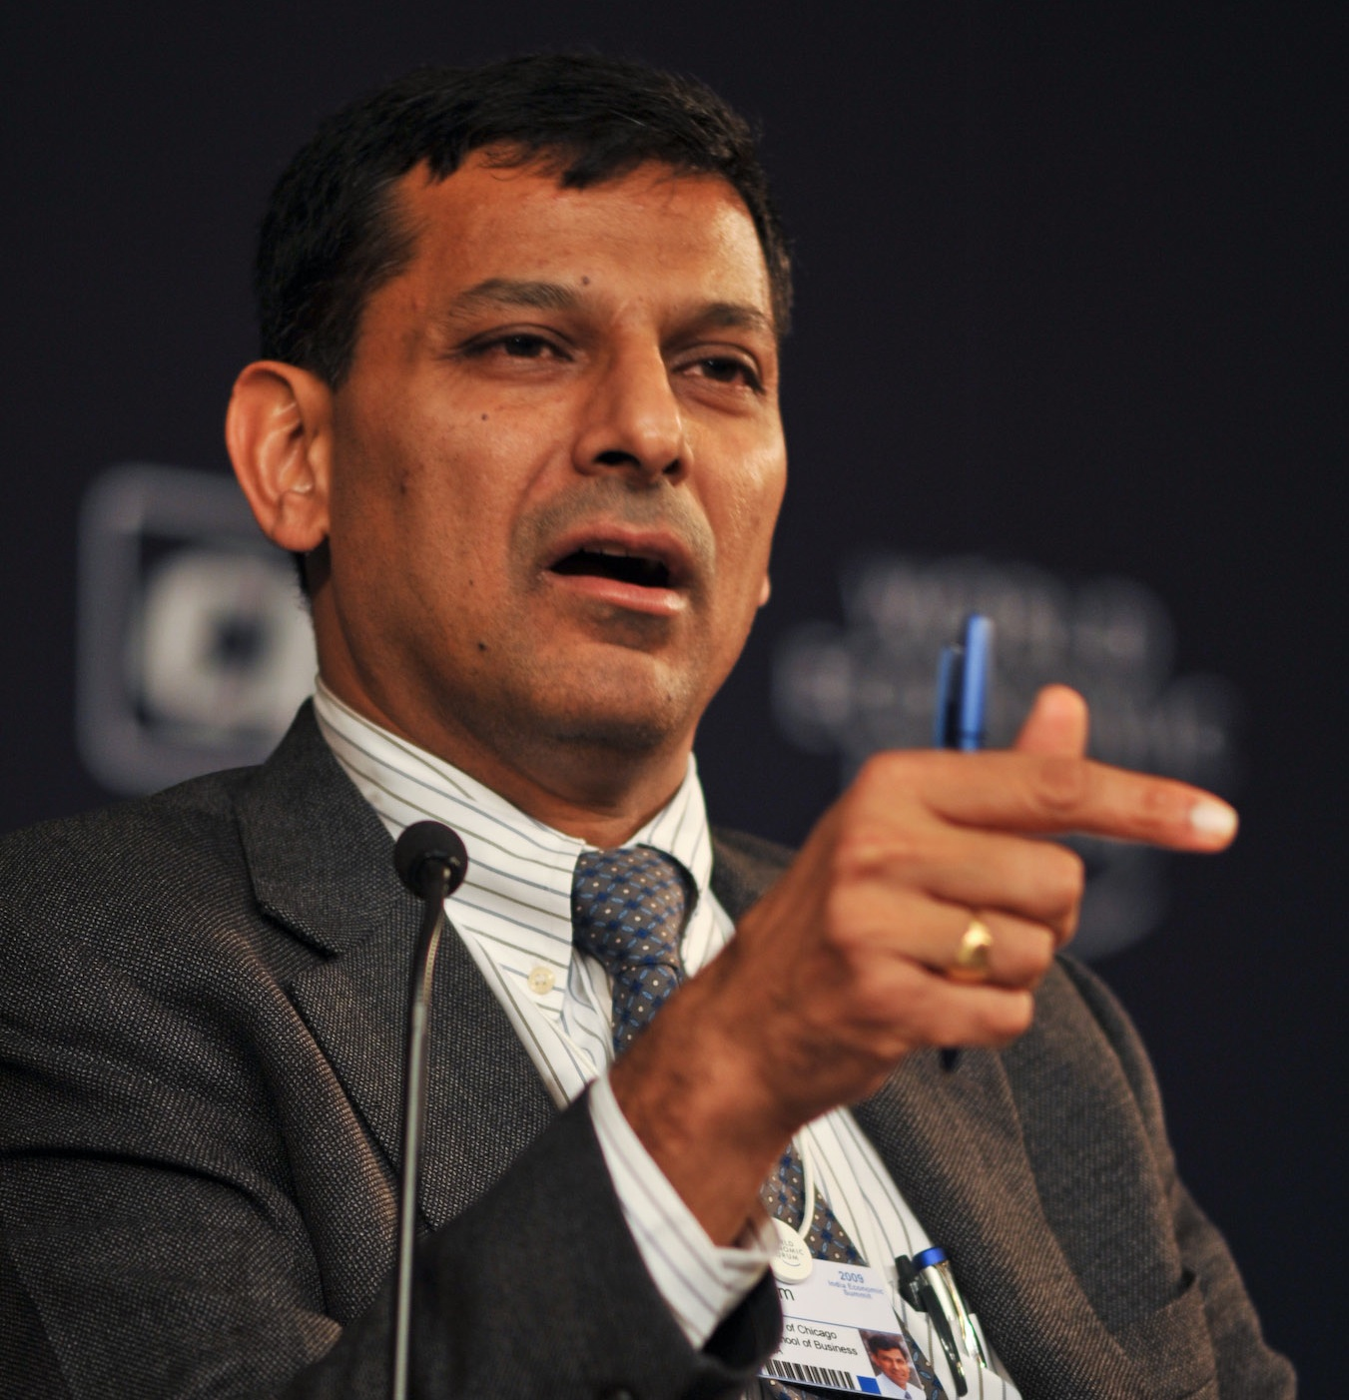
New Differential Banks
India should also have small banks and payment banks
- Nachiket Mor Committee on Financial inclusion (2014, Jan)
Small F.Banks
Payment Banks
Wholesale Banks
Custodian Banks
Why need them?
What’re their features?
2016: Apr. Monetary Policy suggested
Ok, invite applications [2014, Nov.]
@Usha Thorat, select small banks
@Nachiket, select Payment banks
Declare Winners [2015, Sept.]

Slide 18
Structure: Payment Banks, Small F.Banks
Equity (Owners/ Proprietors)
Bonds/Debentures/Loan
Must pay interest, principal irrespective of profit / loss
Partnership, IPO-Shares, VCF, Angel Investor
Dividend if profit
Last claim during liquidation
First claim during liquidation
Debt (Creditors)
Capital
Must have min.100 cr. Equity capital
Must register as a public ltd. company

Slide 19
BASEL-III norms on Small / Payment banks?
Equity (Min.100cr.)
Debt
Capital
Min.15%
CRAR
I’m free to prescribe even higher requirement
List not exhaustive
Tier1
Common shares
Tier2
Debt (Bonds)
Preferential shares
Hybrid instruments (L2/P1)
RWA
So, roughly if started with only 100cr. Capital => play loan/ investment game upto 666 cr. Only until you get more capital.
RBI: 7.5% of CRAR must be in Tier1
Tier-2 can’t be more than 100% tier-1
Notes:
https://rbi.org.in/scripts/bs_viewcontent.aspx?Id=2901

Slide 20
Companies Act 2013
One person company
Private Ltd
Public Ltd.
1 Member
2-200 members
7-unlimited
Listed / Unlisted
Capital req: 5 lakh
Min Paid up Capital Req: 1 lakh
Small/Payment bank min. equity capital 100 cr. Required.
Red = removed with Companies Act amendment in 2015
Counter: Shell companies and tax avoidance

Slide 21
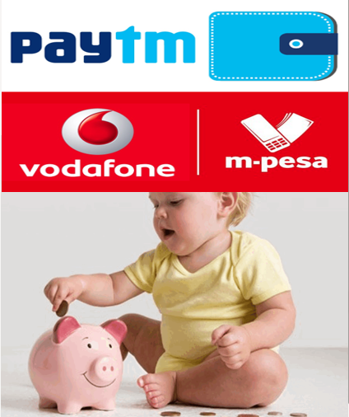
So far
BoD
Chairman
Executive Director/Full-time
Nominated (Bank/CG)
Independent Director
MD & CEO
Shareholders
Majority of directors must be independent
Equity (Min.100cr.)
Debt
Capital

Slide 22
No. of Directors (Compulsory under Companies Act)
Companies Act 2013
Public Ltd.
7-unlimited
One person
Private ltd.
2-200
1
Min. 2 Max15
Min.3- Max15
As per Companies Act
One director Indian resident (182 days)
One director Woman
1/3rd Must be independent
Independent Director Means
Promoter….. X
Pecuniary interest…X (except salary)
Employee…X
1 person can ID in max 7 cos
5 years x 2 terms x cooling off 3 years
Why need them?
protect interest of (minority) shareholders
enforce corporate governance
In Small Banks, Payment Banks: majority directors must be independent

Slide 23
Common Features
Public ltd. Company under companies Act
Licensed under Banking regulation Act 1949 [not NBFC]
Schedule Bank under RBI Act 1934
Payment and Settlement Systems Act, 2007 [NEFT,RTGS Ref:Bitcoin.pptx]
In-principal approval for 18 months only – must begins ops by then.

Slide 24
Common Features
Customer protection?
Majority of directors must be independent= corporate governance
Protected by RBI’s Banking Ombudsman Scheme, 2006.
Inspired from UK, setup in ’95; not in J&K
Post manned by RBI’s GM/CGM
Max. comp-10 lakh;
Appeal: Dy.Gov.RBI
SCB,RRB,Co-op,loan-giver NBFCs also covered
Protected by Deposit Insurance and Credit Guarantee Corporation of India (DICGCI)

Slide 25
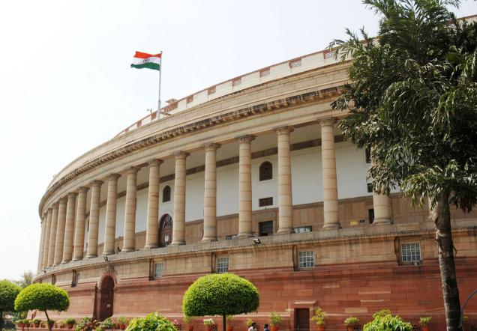

DICGC Act 1961
Fuction#1: Deposit insurance
Max.1 lakh / customer if bank fails
Fuction#2: Credit Guarantee (PSL)
Compulsory for Banks to take insurance on its deposits from DICGC (& pay premium)
Farmer loan fail: can’t do SARFAESI recovery- but DICGC pays bank.
Also for PSL (except home loans)
100% ownership
1 RBI Dy.Gov is Chairman
Notes:
Later became public ltd. Company
Financial Stability and Development Council (FSDC) => they setup a panel under Anand Sinha (RBI Dy.Governor) + Arvind Mayaram (Finance Secretary ).
This Sinha-Mayaram panel recommended creating Financial Resolution Authority FRA.
Functions:
Solve crisis in all financial institutions. Not just banking, but non-banking financial institutions also e.g. Muthoot Gold Loans, Reliance Mutual funds.
FRA will protect all depositors (in banks) and all investors (in non-banking function financial institutions)
FRA will subsume the above Deposit Insurance and Credit Guarantee Corporation (DICGC)
WE need to create FRA, because all financial markets are interconnected. A crisis in banking sector, can have negative fallout even on share market (and thereby mutual funds), and vice versa.
This FRA will be independent of govt. and financial regulators (such as RBI, SEBI, IRDA)
FRA can prevent bank failure, and reduce damage to economy
Apart from “insurance premium”, FRA can also arrange money by issuing bonds (And that bond-money can be used for resucing the failed bank/institution.

Slide 26
Common Features
FDI: 49% automatic, upto 74% with approval
Can access repo market
Can open branch, ATM, appoint Business Correspondent (BC)
Can Sell MF, Pension, Insurance, foreign currency, but can't use its own funds
CRR, SLR applicable*
Notes:
At all times, at least 26 per cent of the paid-up capital will have to be held by residents

Slide 27
Different Norms: Eligibility?
10 small finance banks
11 payments banks
Existing PPI (pre-paid payment instrument)
Individual with 10 year xp in banking/finance
individuals / professionals; Non-Banking Finance Companies (NBFCs), corporate BCs, mobile telephone companies, super-market chains, companies, real sector cooperatives; that are owned and controlled by residents; and public sector entities
Existing NBFC, Microfinance,LAB
Preference to NE, Central India clusters
Notes:
A’bad / TN = SSI edge in PSL
No credit card= no KCC

Slide 28
Different Norms: Who won?
Small F. Banks (10/72)
Au Financiers (Jaipur)
Equitas Holdings (Chennai)
ESAF Microfin (Chennai)
Janalakshmi Financial Services (Bengaluru)
RGVN (Northeast) Microfin (Guwahati)
Suryoday Microfin (Navi Mumbai)
Ujjivan Financial Services (Bengaluru)
Utkarsh Microfin (Varanasi)
Payment Banks (11/41)
Department of Posts
Fino PayTech Ltd (backed by IFC-W.Bank)
Reliance Industries Ltd (Mukesh+SBI)
Dilip Shantilal Shanghvi (Sun Pharma)
Vijay Shekhar Sharma (Paytm)
Vodafone m-pesa (tied with ICICI)
Aditya Birla Nuvo Ltd (with IDEA)
Tech Mahindra Ltd
Airtel M Commerce Services Ltd (with Kotak Mahindra Bank)
Cholamandalam Distri. Services Ltd
National Securities Depository Ltd
Capital Local Area Bank (Jalandhar)
Disha Microfin (Ahmedabad)
Ex-Dy Gov. Usha Thorat
RBI Board Dir. Nachiket Mor
Notes:
A’bad / TN = SSI edge in PSL
No credit card= no KCC
http://www.financialexpress.com/article/industry/banking-finance/rbi-grants-approval-to-10-entities-for-small-banks-all-you-need-to-know/137194/
The prominent names among 30 applicants which lost out in the race a licence include NSE Strategic Investment Corporation Limited promoted by the National Stock Exchange, MG George Muthoot, Videocon d2h and Kishore L Biyani. Payment solutions companies, including Itz Cash Card, Citrus Payment, Smart Payment Solutions, One Mobikwik and Oxigen Services did not make up the grade.

Slide 29
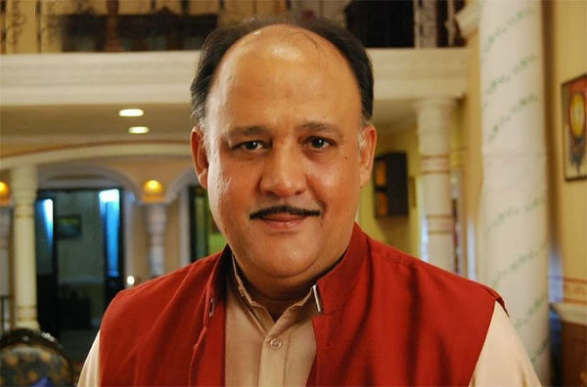
Different Norms: Client Base?
10 small finance banks
11 payments banks
Promoting Small savings
Unserved
Underserved
Farmers-small, marginal
Micro, Small industries
Remittance to migrant labour families, low income households, unorg. Sector, small business
Notes:
A’bad / TN = SSI edge in PSL
No credit card= no KCC

Slide 30
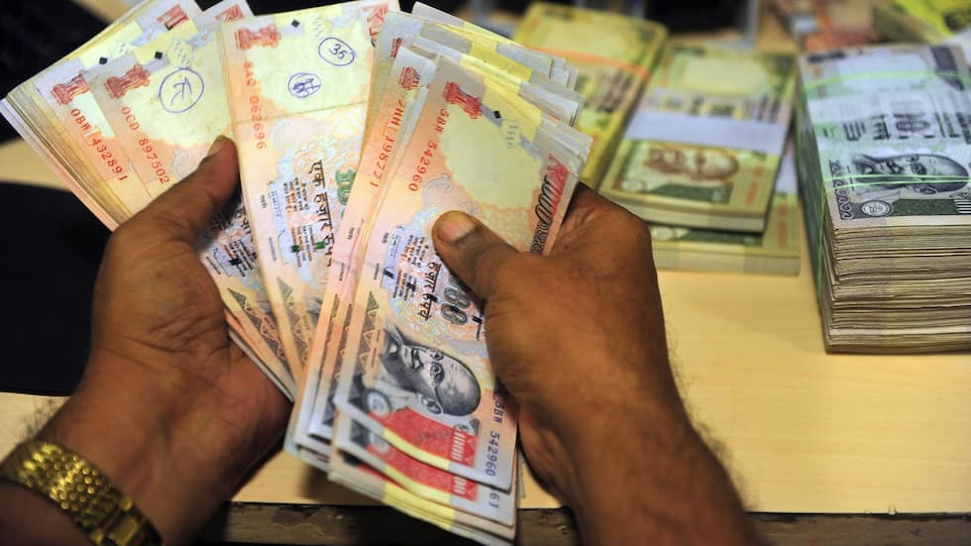
Different Norms: Deposits
10 small finance banks
11 payments banks
No such limits
Time & Demand…yes
Max. balance Rs.1 lakh per year per customer
No NRI deposits
NO CREDIT CARD.
YES ATM/DEBIT
Notes:
A’bad / TN = SSI edge in PSL
No credit card= no KCC
Demand Deposit: Small Savings Account
Aggregate Rs.1 lakh per year
Withdraw max. 10k per month
Max. Balance @Anytime 50k

Slide 31

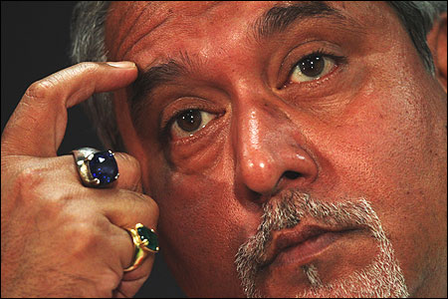
Different Norms: Loan Business
10 small finance banks
11 payments banks
Can’t loan, So no PSL
40% strictly categorywise as SCB-PSL
35% into PSL with edge
=Total 75% PSL
50% of loan portfolio upto 25 Lakhs’ loans
Can’t issue credit card
75% of Demand deposits in Gsec,T-Bill
Max.25% of all deposits in other SCB
Apne Maali aur Driver ke naam se loan letaa hu ☺
☹☹ haath aayaa par munh naa lagaa
Notes:
A’bad / TN = SSI edge in PSL
No credit card= no KCC

Slide 32
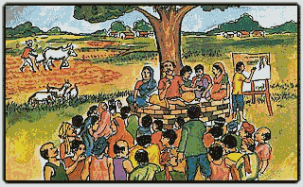
Different Norms: Rural Penetration
10 small finance banks
25% branches in unbanked rural area with upto 9,999 pop. Under Census-2011
11 payments banks
No need, but 25% of access points must be with rural-BC
Notes:
http://censusindia.gov.in/2011-prov-results/paper2/data_files/India2/1.%20Data%20Highlight.pdf

Slide 33
Different Norms: Business Correspondent
10 small finance banks
Can’t become BC of another bank
11 payments banks
Can Become BC of another bank

Slide 34
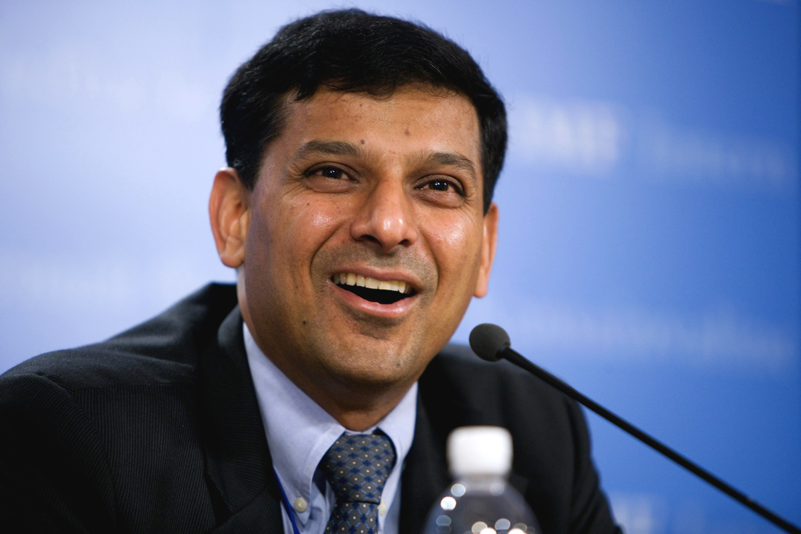
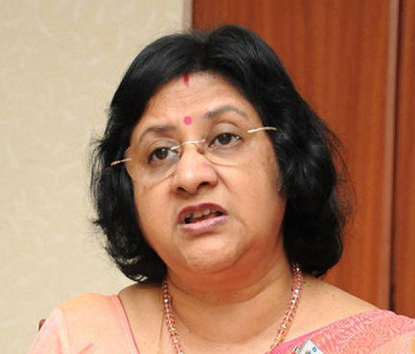
Different Norms: Future growth & evolution
10 small finance banks
Can evolve into Universal Bank after 5 years, on RBI discretion
11 payments banks
Not explicitly mentioned
Competition among business firms =better services for clients.
As in Delhi’s coaching classes
SCBs already troubled…now more competition? ☹

Slide 35

New Differential Banks
Small F.Banks
Payment Banks
Wholesale Banks
Custodian Banks
Why need them?
What’re their features?
2016: Apr. Monetary Policy suggested
Criticism
Kyoki inko Mazaa nahi aayegaa

Slide 36


Criticism: Deposit- when even SCB worried with growth ▼
@Payment Bank
Max. Balance limit of Rs.1L is rather too low. I’ll have to shift to SCB at some point= “financial exclusion”
@both,
I already opened account in PM-Jan Dhan Yojana, with Rs.5k overdraft facility & Rupay card in xyz PSB!!
My LPG-DBT, MNREGA payment comes directly in jan dhan account…
Why should I trust a new bank & shift my money from that PSB to here?

Slide 37

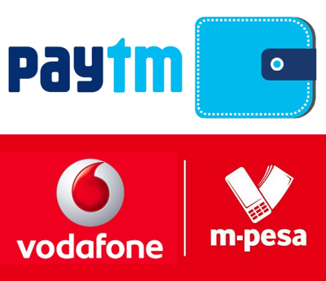
Criticism: Payment Bank- Difficult to mobilize deposits
No NRI deposits allowed, unlike Kenya.
Kerala migrants in Middle East still to use Hawala?
PPI=Rewards / Discount driven “digital wallet” model =hit among youth
Digital wallet=>Savings account= KYC docs needed hence conversion difficult.
9/10 transaction in cash and coin. So digital wallet=> Last mile delivery??
+competition from Small F.Banks

Slide 38



Criticism: Small Bank: Loans to SME, Startups
Small Banks: 40+ 35% PSL
Help Micro and Small enterprises
50% of loan portfolio: 25lakh/<
Through MFI, SCB, RRB..
Shishu: upto 50k
Kishor: >50k-5L
Tarun: >5L-10L
Difficult to meet PSL targets
Credit bureaus don’t keep record of villagers; will have to hire local experts else NPA?
Duplication of efforts? Competition with SCB,RRB?
Why not shut down RRB,UCB 1st?
What if same beneficiary recycled by creating multiple shell firms?
Each branch to give atleast
1 loan to SC/ST; 1 to woman Greenfield non-farm Rs.10L to 1 Cr.
SIDBI=> Banks (10k cr.)

Slide 39
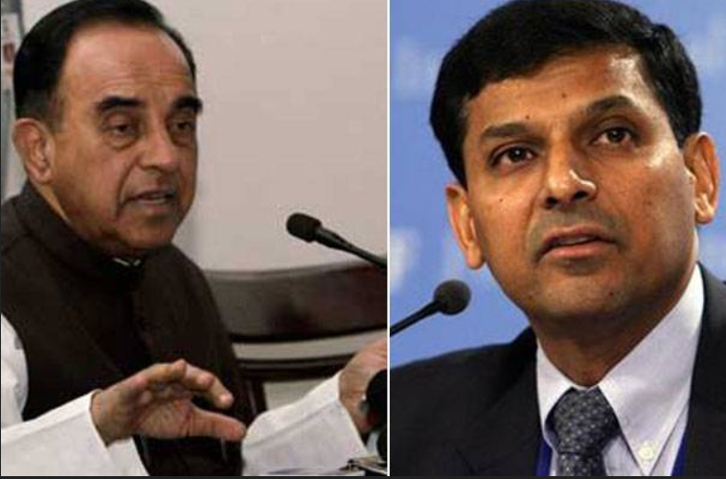
Subramanium Swami
Diff.Banks
Why only 10 SFB, 11 Payment Banks?
More winners= competition = cheaper products & better services as in Delhi’s coaching classes.
Arbitrary license, vague guidelines
Payment Banks= PPIs who can take deposits but can’t lend- so why call them “bank”?
Launch ED investigation against Rajan
Raaste ki parwah krtaa rha toh manzil boora maan jaayegi.

Slide 40
Differential banks
Justification
RBI – declared small set of winners, for experimentation
Why did survey’s “4R4D” recommended more number and more type of banks?
Why does USA allow community banks despite far better developed banking industry?
Tighter CRAR norms, independent directors, Banking ombudsman…mischief unlikely.
My name is Rajan & I do what I do

Slide 41
Diffl. Banks for Financial inclusion
Justification
If PSBs panacea for financial inclusion then Why Shardha chit fund scam W.Bengal?
SCB=> Bankassurance, MF; Small/Payment banks entering market = lower commission, better for clients
Airtel, Vodafone= network of retail recharge-walla.=> Banking penetration
Payment banks can act as BC for SCBs
Naan solrathaiyum seiven, sollathathiyum seiven (I'll do what I say. I'll also do what I don't say)

Slide 42
PPI to Payment Banks
Justification
PPI=>Payment Banks: “less cash society”- less evasion of taxes
PPI digital wallet= no interest, can’t “takeout” money, only reward and discount. What’s wrong in converting to savings account?
PPI=> Banks => KYC, less money laundering
Payment bank Rs.1lakh balance limit can be relaxed later. Besides Paytm PPI-Digital wallet who kept Rs.1 lakh in that !?
“Creative Products”- e.g. seed insurance
Naan oru thadava sonna, nooru thadava sonna maadiri (If I say something even once, it's as though I've said it a hundred times)

Slide 43

Arundhati Bharacharya criticised
Diff.Banks
Small/Payment banks have no viable business model, YET.
Payment banks unlikely to take away customers from SCB. Bank customers will not shift to “mobile-wallas”.
deep-pocket corporates entering payments banking="dog eat dog" scenario- like aviation.
then why does SBI have 30% stakes in Reliance Payment Bank?
Q3-2015 profit decline, credit & deposit growth▼, MCLR ka gussa mujh pe kyo? Not just Small/Payment banks, now I’ll open Custodian & wholesale banks also…then all PSBs will know ki Aag, Paani aur Bhai se ____.
Notes:
, predatory products, self-destructive like aviation

Slide 44
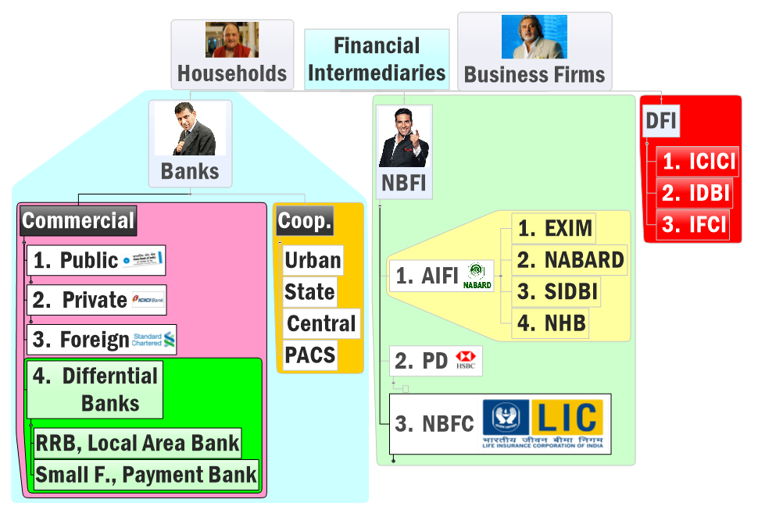

Before Narsimhan-II 1998
DFI

Slide 45
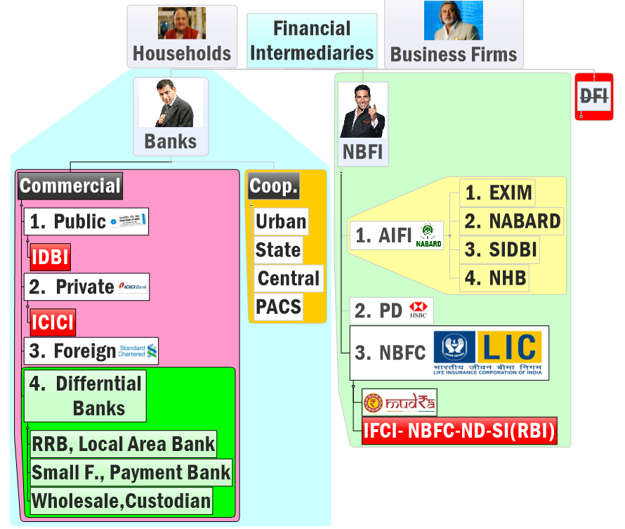
After Narsimhan-II 1998
DFI
2015
Future plan, As per Monetary policy 2016 April.

Slide 46
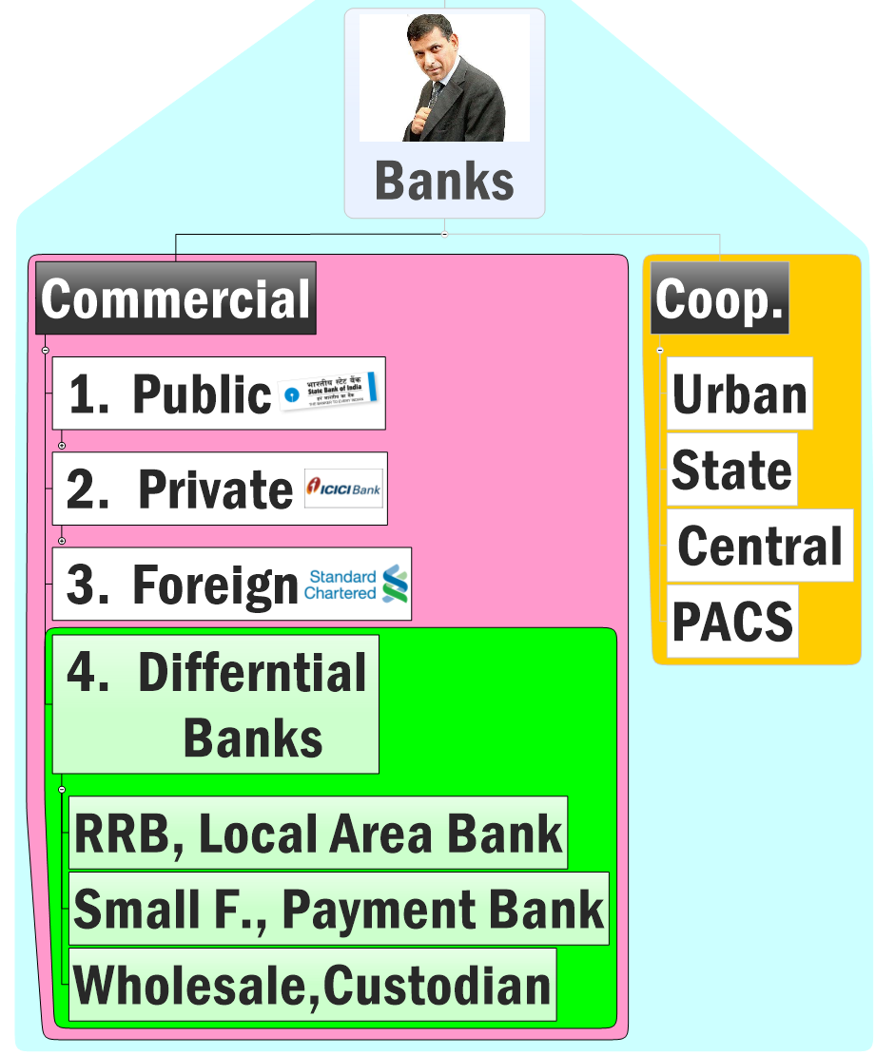
Retail Finance and Corporate Finance
PSBs becoming jack of all trades- agri loans, fin. Inclusion to corporate finance= NPA, BASEL crisis
++Consolidation, privatization difficult
can’t help large borrowers
Mired with scams and inefficiency
Not giving enough competition
Few branches, qty wise PSL= low
Only 4, convert them to SFB
Hardly 3% deposits, consolidate RRBs
Migrant remittance, urban
Infra/devl. loans

Slide 47
Differential Banks
Small F.Banks
Payment Banks
Wholesale Banks
Custodian Banks
2015: Finished Selection
2016: Apr. Monetary Policy suggested
RBI’s Nachiket Mor Committee on Financial inclusion (2014) Suggested Differential Banks /Niche banking

Slide 48

Wholesale Bank (Nachiket)
Differential Banks
Only accept Deposit >Rs.5 cr.
CRR, SLR….Yes
Only give loans to infra/corporates
SAFAESI Powers…Yes
PSL: help retail banks fulfill theirs (e.g. Mega food park=> PSLC Certi.=>)

Slide 49

Custodian Bank
Differential Banks
Clear guidelines, functions yet to be announced by RBI
Safekeeping of securities, derivatives, MF, metals, commodities, foreign currency etc.
Keep client informed about yield, AGM etc.
Execute deals for client

Slide 50
Differential Banks
Small F.Banks
Payment Banks
Wholesale Banks
Custodian Banks
2015: Finished Selection
2016: Apr. Monetary Policy suggested
RBI’s Nachiket Mor Committee on Financial inclusion (2014) Suggested Differential Banks /Niche banking

Slide 51
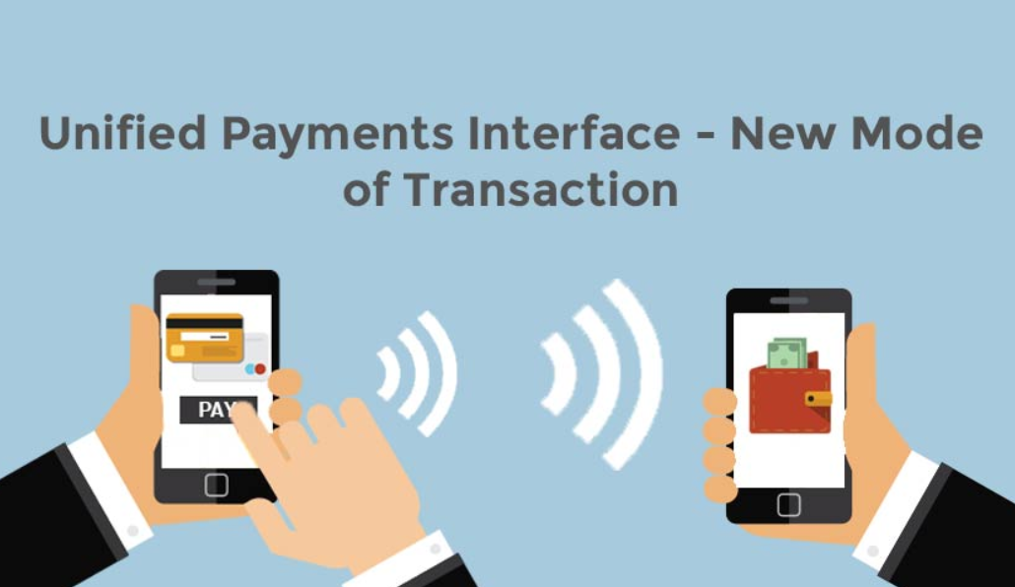
NPCI- success story
Sidetopic-UPI
Cashless transactions: Good for RBI+Govt
National payment Corporation of India –
NPCI =umbrella organization for all retail payments, operates Rupay Network; Adhar enabled payment services
Bharat Bill Payment System (BBPS): Single webportal to pay all utility bills- gas, electricity, telephone, cable-DTH; also managed by NPCI
Unified Payment Interface (UPI) from 1/4/16
Notes:
2 factor authentication
Physical Card + PIN
Card# + OTP
Bank username and Password + OTP

Slide 52
Unified payment interface
Sidetopic-UPI
Login to Gmail=> ‘To’ address=> email
Similarly all Banks/online shopping mobile apps & websites =>virtual address=>$$ remittance.
NPCI’s UPI Generates virtual address
9800011111@airtelmobile.npci
12345@HDFC0000001.ifsc.npci
Notes:
2 factor authentication
Physical Card + PIN
Card# + OTP
Bank username and Password + OTP

Slide 53

Conditional Push Transactions e.g. Pay after delivery
Security: 2 factor authentication; OTP, physical swap etc.
Scan and Pay: barcode based; Fees, donations, e-toll payment, “Apple Pay” etc.
“Inbox” Notification and snooze options
Pull Transactions- automatic bill recovery. NPCI’s Bharat Bill Payment System (BBPS)

Slide 54
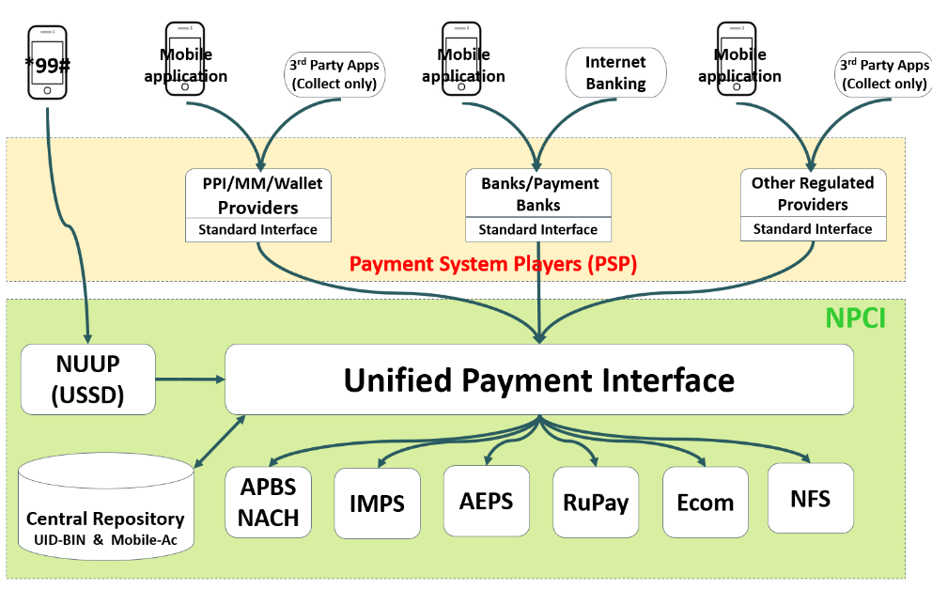
technically

Slide 55

Theory +Economic Survey Vol.2 + Vol.1 + Budget 2016
1.Banking Finance
6.HRD
2.Budget-Fiscal Policy
3.BoP
4.Sectors of Economy
5.Infra
V2C2-Pub.Fin; V1C3-JAM
V2C3-Monetary mgmt+FI
V2C4-External sector
V2C5-Price,Agri.; V2C6,7
V2C8-Paris Summit, Energy
V2C9-Social infra.
V1C4-Agri ; V1C9-Fertilizer
V1C5-mother-child
V1C6-bounties; V1C7-Fiscal Cap
V1C8-PTA
V1C2-Chakravy; V1C10-Labour
V1C11-Powering 1 India
B1. Financial Sector Reforms
B2. Fiscal Discipline
B3. Tax Reforms; B4. Ease of
B5. Agro: 2x farmer income
B6. Rural infra-employment
B7. Infrastructure
B8. Social Sector & healthcare
B9. Education, Skills, Jobs
V2C1- Chakravyuh challenge
V1C1- Twin Balancesheet
Mostly done; not much on “finance” except merger of SEBI-FMC; remainder of ECB-under BoP; Startup/Infra finance-separate pillars and so on
+Survey Ch.1s Spread throughout; SDG-Goal esp. @#4,5,6; HDI Report@6

Slide 56
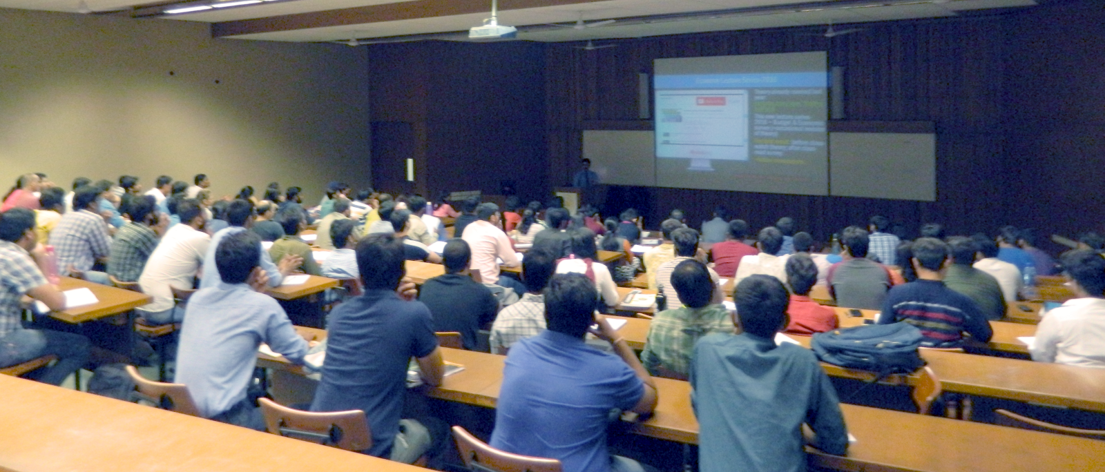
For best results..
Self study After Today’s Lecture
V1C1- Twin Balancesheet
V2C3-Monetary mgmt+FI
V2C1- Chakravyuh challenge
Before next lecture ;
Finance “L2”;
Budget “L4”
youtube.com/user/TheMrunalPatel
+ Daily English newspaper: Hindu (1st Preference) OR Indianexpress

